Slide 1
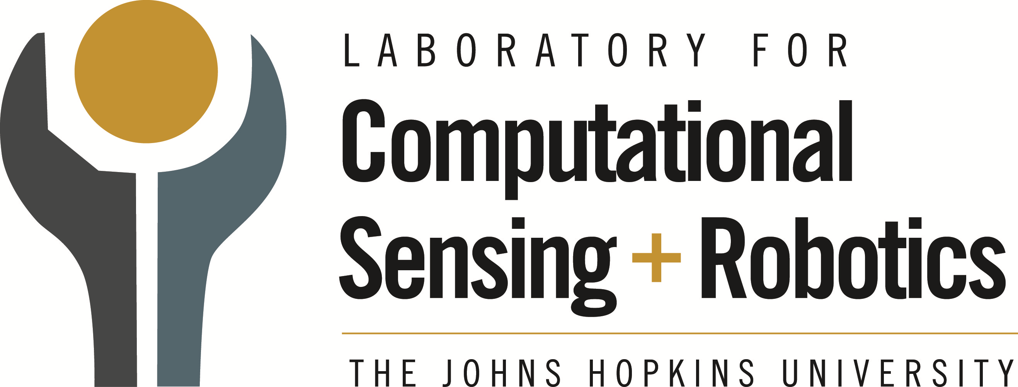

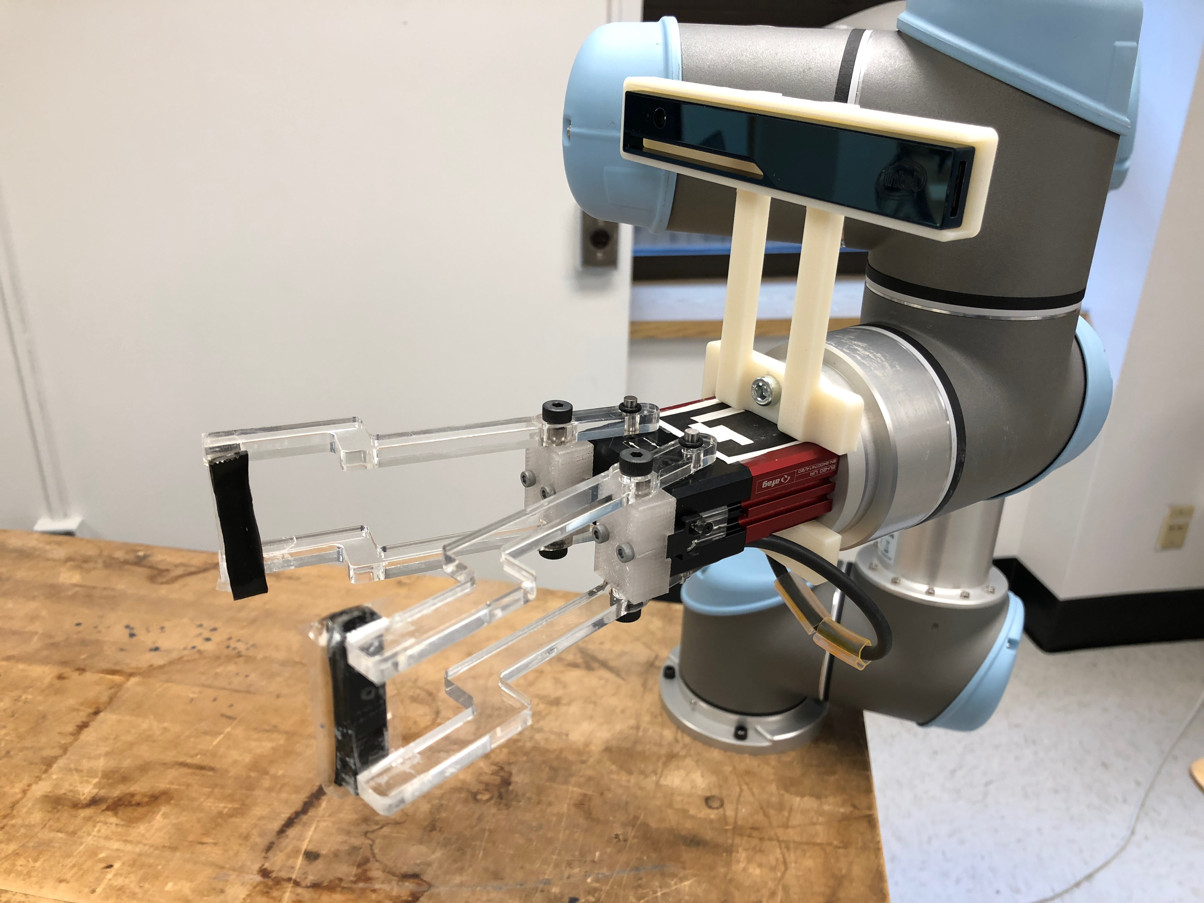
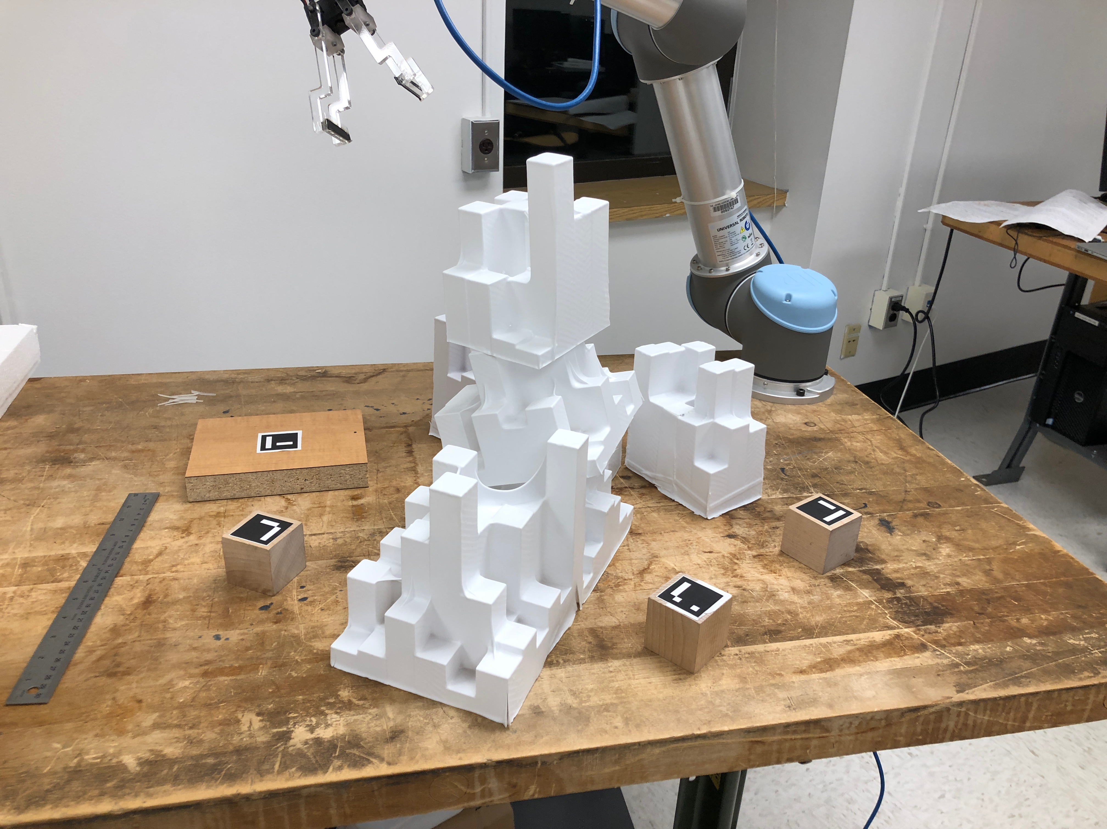
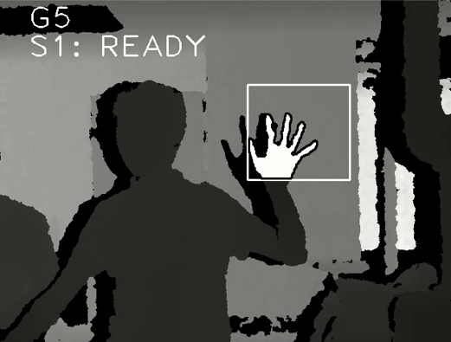
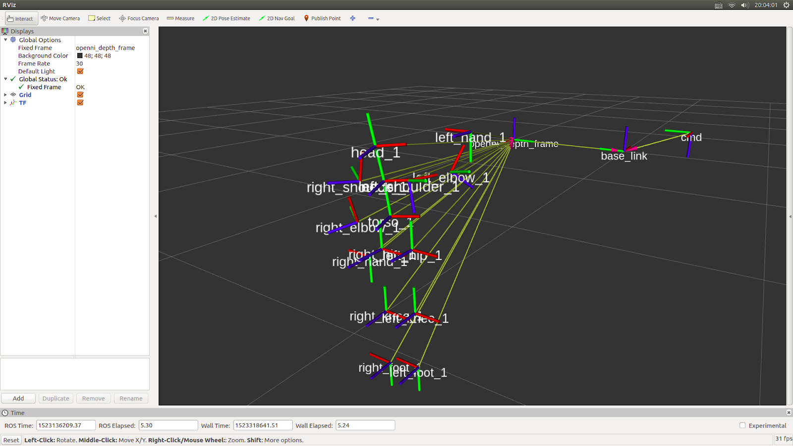
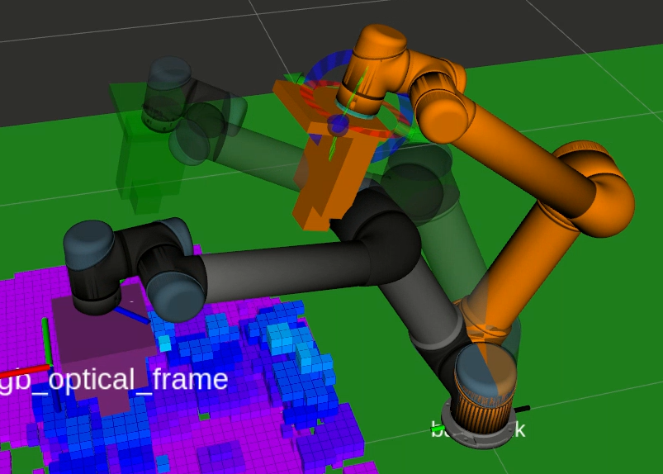
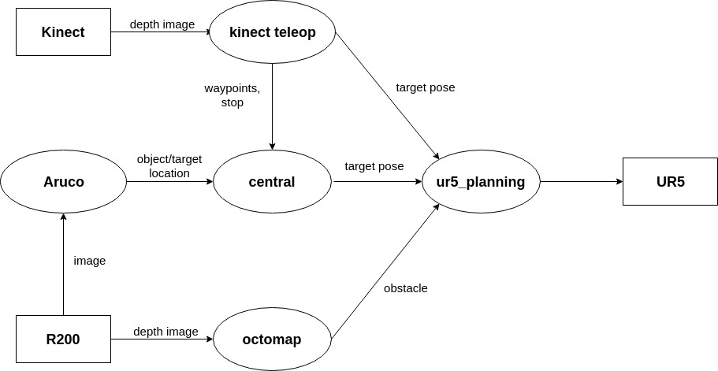
UR5 Obstacle-Avoidance Pick-and-Place with Arm Assistance
Yucheng Kang, Zhiyi Ren
530.707 Robot Systems Programming Independent Class Project, Spring 2018
Johns Hopkins University | Whiting School of Engineering | Baltimore, MD
Motivation
Work Flow
UR5 is a widely-used, 6DOF collaborative industrial robot arm. With a RGBD camera and gripper mounted, UR5 can sense the objects and perform pick-and-place tasks. However, when UR5 faces a cluster of unknown obstacles and objects, it may ﬁnd it diﬃcult to map the environment by itself. Unlike mobile robot that can avoid obstacles and map the environment as it moves, UR5 motion is much more restricted. We would like to use human arm movement to guide UR5 move around, avoid the obstacles, and construct the map ﬁrst before moving objects.
After the map is constructed, UR5 can now move small wooden cubes to the target location by detecting the visual markers. Existing motion planning algorithms can sufficiently help UR5 avoid obstacles.
User calibrates skeleton tracking in front of Kinect camera.
User makes a “START” gesture to tell UR5 to start following the arm and mapping.
User moves an arm around, and UR5 follows to construct an obstacle map of the environment. It also detects the ArUco tags at objects and target location.
User makes a ”STOP” gesture to tell UR5 to stop following the arm and start pick-and-place.
Moveit loads the constructed map from octomap server.
Moveit plans and executes UR5 to pick-and-place objects. Use cartesian path when approaching the object.
Hardware and Infrastructure
Robot
Gripper
Camera
Others
UR5, 6 DOF collaborative industrial robot arm.
Afag EU-20 UR gripper.
Microsoft Kinect V1: arm and hand gesture detection.
Intel RealSense R200: obstacle mapping, visual marker detection.
ArUco markers [1], 3D-printed camera mount, wooden cubes, vacuum-formed polystyrene obstacles
Figure 1—Hardware
UR5 with gripper and R200 camera, obstacles, ArUco markers, and objects.
Lessons Learned
Moveit framework is highly complicated, and it provides both easy and advanced interface APIs. We started with the advanced one, but soon realized that many of the features are unnecessary. We then restarted with the easy one, and implemented advanced features if needed.
Real-time updating Octomap with Moveit plugin updater in Rviz is very CPU/RAM-consuming.
rqt_launchtree can be used to analyze large launch files. It helped us better understand and quickly look up the structure of the Moveit framework.
Realsense R200 camera has a minimum range of ~0.5m for depth image, so it is important to keep it away from obstacles while constructing octomap.
Hand segmentation can be achieved in both depth images and RGB images. However, in depth images, the user’s hand must be close to Kinect due to the low resolution; in RGB images, the color threshold is somewhat sensitive to the lighting.
Existing Software
The project involves integrating a few existing software packages to use the Kinect camera, R200 camera, Octomap, Moveit [2], ArUco markers, and UR5 arm. Major packages include
universal_robot (wiki.ros.org/universal_robot) drivers, descriptions, and utilities for UR5 in ROS.
ur5_modern_driver (github.com/ThomasTimm/ur_modern_driver) new driver for UR5 in ROS, improved usability and ros_control compatibility.
aruco_ros (wiki.ros.org/aruco_ros) real-time 3D pose estimation of ArUco markers in ROS.
Since the camera is moving, sometimes it does not see all the markers, but we want Moveit to know where the markers are throughout the mapping process. Thus we implemented the node to keep publishing the most recent available transform from UR5 base_link to the markers.
Sometimes the output from ArUco libraries is not accurate. We implemented a simple filter to select poses that has vertical Z-axis.
aruco_hand_eye (github.com/jhu-lcsr/aruco_hand_eye) R200 hand-eye calibration using aruco_ros and ViSP.
octomap_mapping (wiki.ros.org/octomap_mapping) 3D occupancy grid mapping using Octrees.
We found that updating octomap in Rviz using Moveit native plugin in real-time is very CPU/RAM-consuming. Rviz is very sluggish and even crashes if user attempts to use Rviz. To solve the issue, we let the octomap server alone constructs the map, and manually load the map into Moveit only once after the mapping process.
octomap_ros (wiki.ros.org/octomap_ros) conversion between ROS and Octomap native types.
openni_camera (wiki.ros.org/openni_camera) ROS driver for Kinect.
openni_tracker (wiki.ros.org/openni_tracker) OpenNI skeleton tracking with tf broadcaster.
vision_opencv (wiki.ros.org/vision_opencv) ROS interface for OpenCV library.
moveit_ros (wiki.ros.org/moveit_ros) Integration of Moveit with ROS.
actionlib (wiki.ros.org/actionlib) standardized ROS interface for preemptable tasks.
Future Work
Intermediate pose Existing motion planning algorithms may cause UR5 to move to a few awkward poses before reaching ﬁnal pose. We would like use hand gesture to input a few intermediate poses into Moveit. We would like to implement a customized probabilistic roadmap planner using these intermediate poses as samples.
Visual servoing Existing related packages such as ViSP [3] can use RGB image to guide robot arm to the objects without the use of visual markers.
Predictive control [4] Published research has implemented model predictive control of UR5 for online generation of optimal trajectories matching user arm position and orientation. This enables UR5 to follow the arm in higher frequency, low latency, and with a smoother trajectory.
Figure 2—Kinect teleoperation
Gesture recognition and skeleton tracking.
New Software
References and Acknowledgements
To implement arm and hand gesture detection, we implemented following software:
kinect_teleop Teleoperation with Kinect
filter the user’s body-to-hand transform given by skeleton tracking
convert this transform to the target pose of UR5 end-effector
recognize the user’s gestures and then feed the results to a simple FSM as inputs
To implement UR5 control and Moveit motion planning, we implemented following software:
central central controller of the system
start and end mapping/pick-and-place tasks based on user input and system feedback.
calculate UR5 end-effector target locations based on ArUco marker inputs.
use a customized action client-server interface ur5_planning for motion request.
ur5_planning customized interface with Moveit
add table, gripper, camera mount, and cube as obstacles into planning scene
Request RRT-Connect or cartesian path planning
We would like to acknowledge the instructor, Dr. Louis Whitcomb, and the TAs, Tyler Paine and Soham Patkar, for the valuable suggestions. We also would like to thank Dr. Noah Cowan for the use of the gripper.
ArUco: a minimal library for Augmented Reality applications based on OpenCV, www.uco.es/investiga/grupos/ava/node/26
Moveit! Motion Planning Framework, docs.ros.org/kinetic/api/moveit_tutorials.
ViSP: Visual Servoing Platform, visp.inria.fr.
Real-Time Predictive Control of an UR5 Robotic Arm Through Human Upper Limb Motion Tracking, Omarali et al, 2017, HRI’17.
Figure 3—Overall Framework, motion planning with Moveit
Octomap with marker frames and motion planning with attached cube for collision checking.

